Slide 1
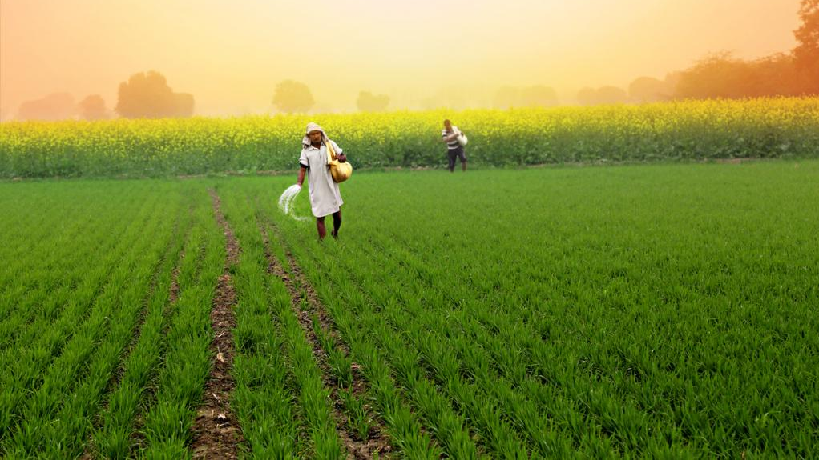
KISHAN - The Farmers App
Re-defining Crop Selling

Slide 2
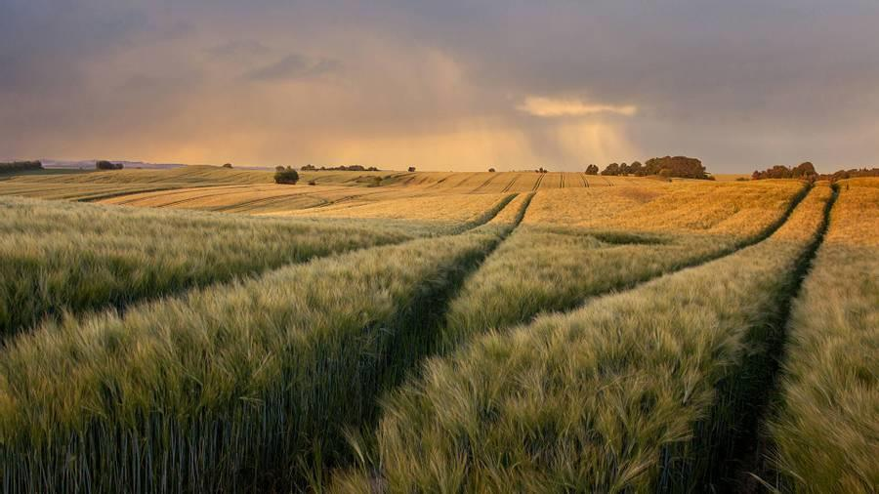
Project demo farmer APP

Slide 3

About us
By using our Kishan Application, Farmer’s can sell:
their products to customers without any third-party vendors.
different crops based on customer’s need.

Slide 4

Application benefits
Farmers will get more money by avoiding to the third-party vendors like distributors & wholesale vendor’s.
Customer also get good & fresh products directly from farmer.
Payment is directly done to the farmers
Customers will delivered with their ordered crops within stipulated amount of time .

Slide 5
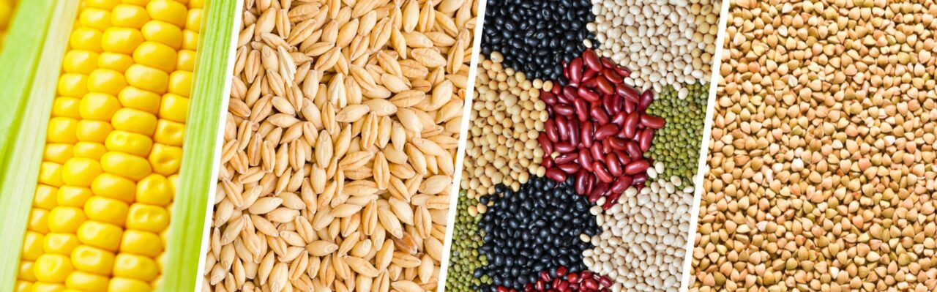
FUNCTIONAL REQUIREMENTS
NON-FUNCTIONAL REQUIREMENTS
Customer Service
Farmer Service
Security Service
API Gateway
Role based authentication
Microservices
Eureka Server

Slide 6
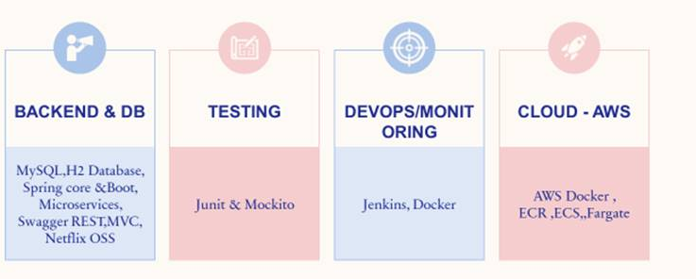
Learning Phase
Goals:
Learn by doing
Learn by observing
Learn by sharing

Slide 7
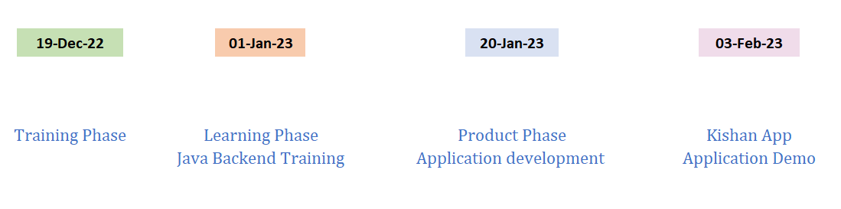
Journey of KISHAN App

Slide 8
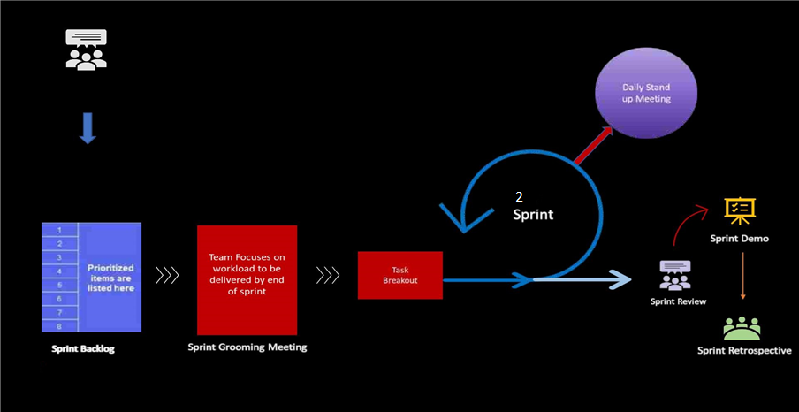
AGILE Methodology

Slide 9
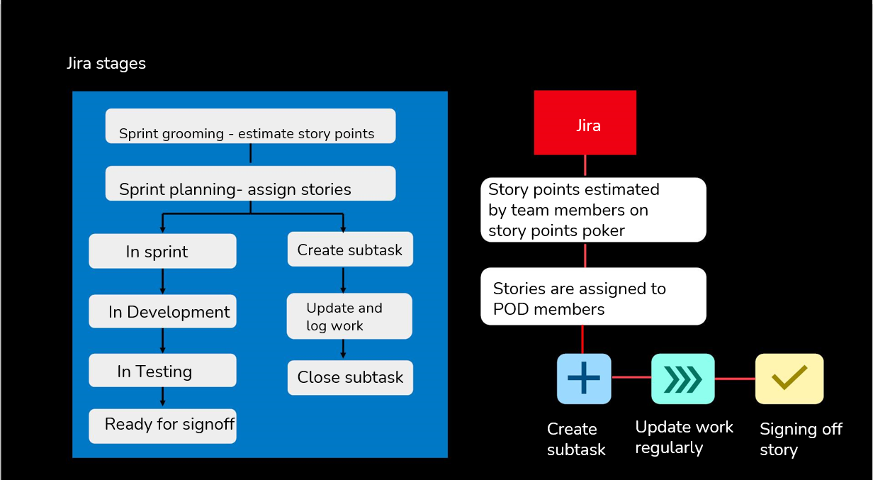
JIRA Stages

Slide 10
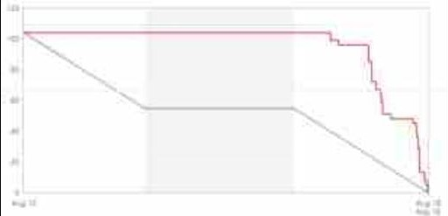
Sprint Burndown Chart

Slide 11
Skill Level Indicator

Slide 12



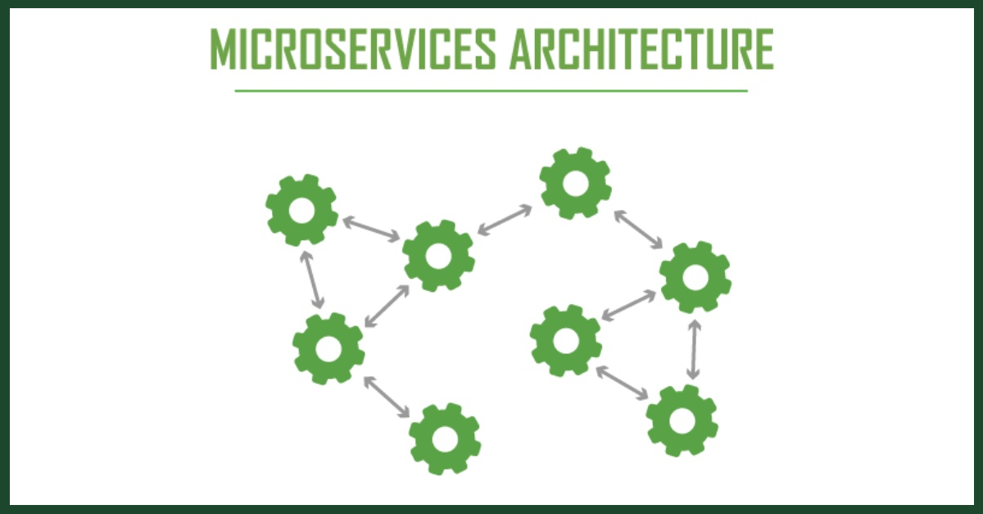








TECHNOLOGIES AND TOOLS USED

Slide 13




CLOUD SERVICES

Slide 14
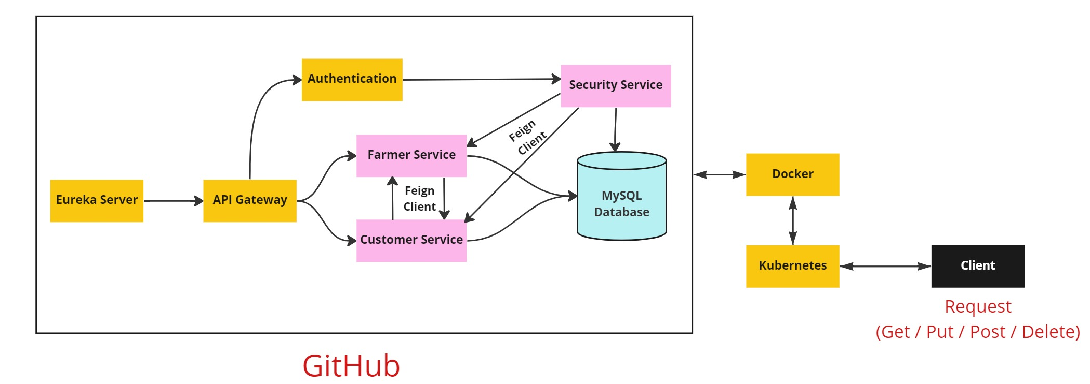
APPLICATION ARCHITECHTURE

Slide 15
APPLICATION FEATURES
Customers Can
Login / Sign Up
Add Available crops to cart
Modify the crops from the Cart
Make the payment.
Farmers Can
Login / Sign Up
Add his/her crops to sell
Modify the content of the crops available
Add price to their crops
Deliver to Customers once they made payment.

Slide 16
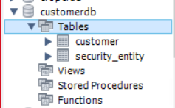
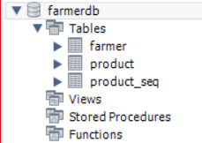
DATABASE DESIGN
Customer DB
Farmer DB

Slide 17


PROJECT FLOW
Customer Login
Customer
Sign Up
Farmer
Login
Farmer
Sign Up
View available crops
Add available crops
Add the needed crops to the cart
Track order
Modify the crops
as per availability
Modify the crops in the cart
Make Payment
Provide the prices for the crops
Deliver to customer after payment

Slide 18
CHALLENGES FACED
Implementing the security level.
Working with Cloud services.
Integrating with the Cloud platform.
Achieving optimal code coverage.
Server issues faced during the cloud-level deployment.

Slide 19
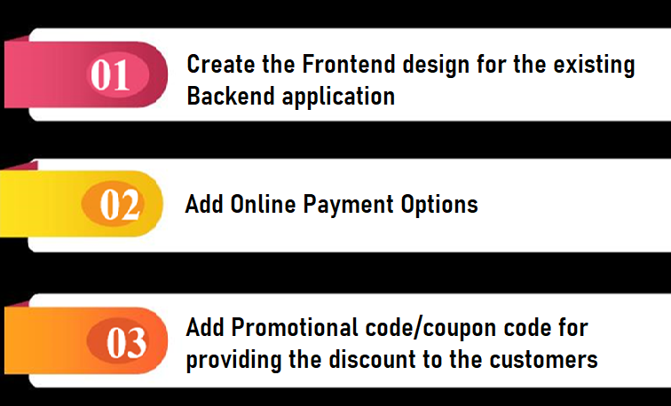
FUTURE SCOPE

Slide 20
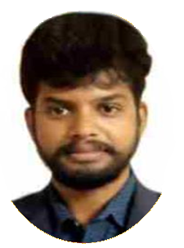
TRAINER TESTIMONIAL
Congratulations to the team for finishing their whole training program. I have observed willingness of everyone to work on the areas that require improvement whenever necessary. Thank you to the entire team for working together to meet the training goal and expectations. You have my support. I wish you all the best of luck.

Slide 21
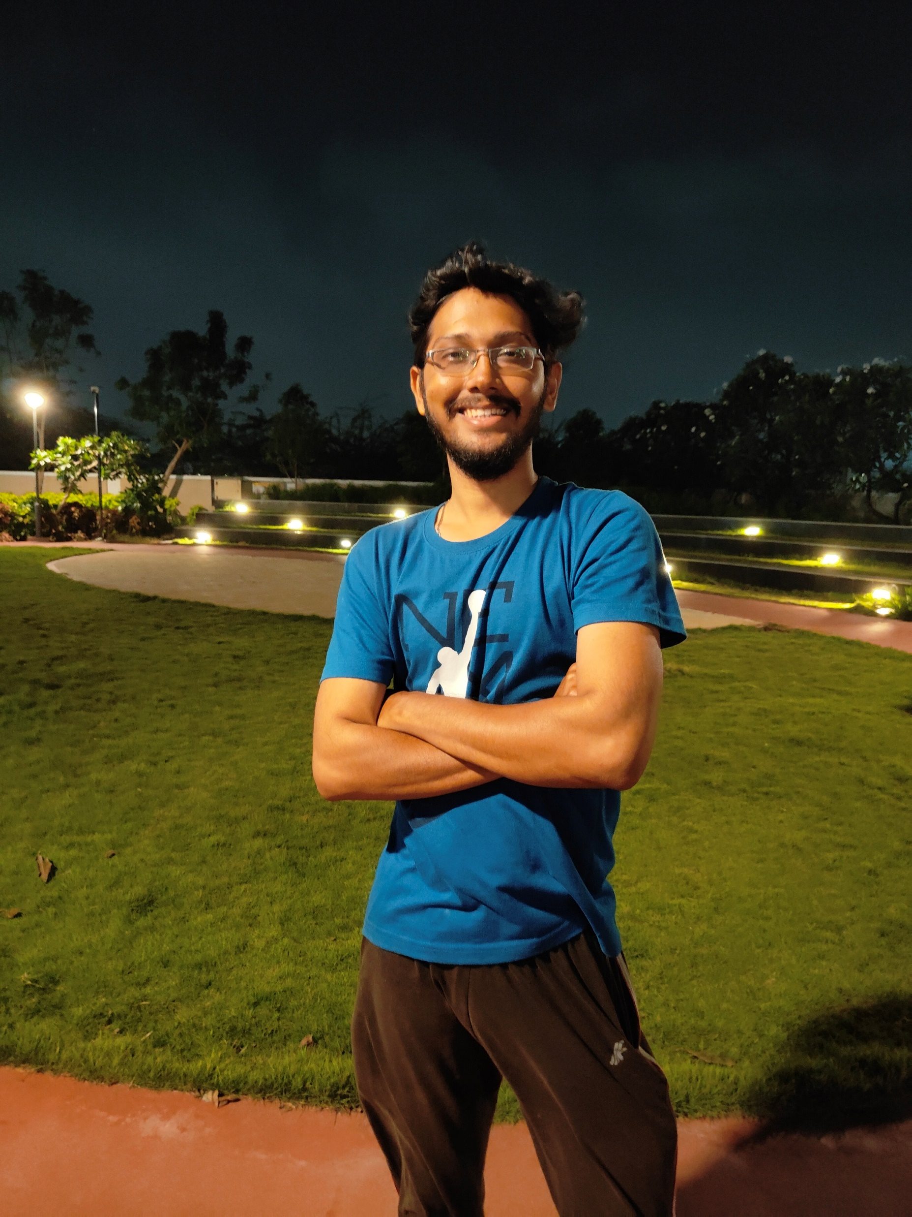
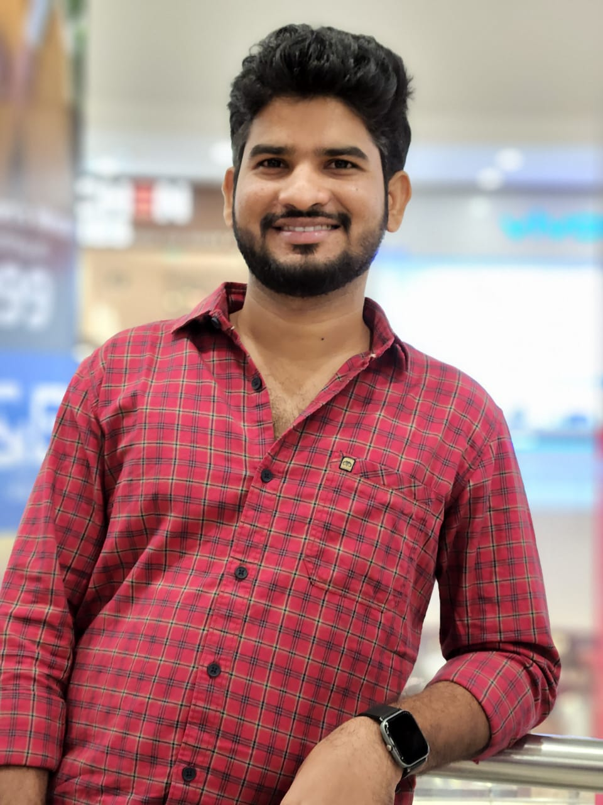
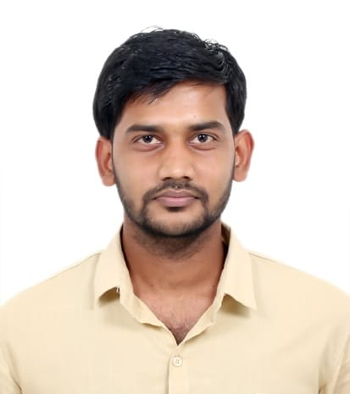
App Developers and our testimonials
Raviteja
Aashish
Krishnamoorthy
We had the privilege of working with Sharath Kumar and we must say they truly exceeded our expectations. His in-depth knowledge and passion for his work was evident in every session, making it both educational and enjoyable. His personalized approach and ability to tailor the training to meet our individual needs was impressive. The result was a marked improvement in our skills and confidence. We would highly recommend Sharath Kumar to anyone looking for a top-notch training experience.

Slide 22

Thank you,
For providing this opportunity to develop this application and allowing us to present it.

